Slide 1
Taking Initiative and Persevering in the Face of Obstacles
Module 8

Slide 2
Taking Initiative and Persevering
Module 8A

Slide 3
Learning Target
I take the initiative to contribute positively and approach challenges head-on.

Slide 4
Select a quote that means something to you.
What Do You Think: I Relate To This Quote Because …
Think about how this quote would sound in your own words.
Explain why you selected this quote!

Slide 5
What Do You Think: I Relate To This Quote Because …
Do you agree or disagree with your quote? Why?
Does it make you think of something that has happened in your life? Explain.
Does it make you question some aspect of life? Tell us more.

Slide 6
Anthony and Rylan’s Stories
Listen carefully to each story and take notes. Be ready to discuss the differences between the two examples.

Slide 7
Definition and Examples
Fill in the definition chart for the word
Initiative

Slide 8
What Do You Think: Quitting Was Never an Option
Use the guiding questions to describe and discuss a time when you showed great resilience!
Refer to the Resiliency Resources if you need some help with your story.
Notes:
http://www.bls.gov/tus/charts/

Slide 9
What is Resilience?
Resilience is the process of adapting in the face of adversity, trauma, or significant stress.
“Bouncing back" is not an ability that people either do or don’t have.
It involves ways of thinking and acting that can be learned and practiced by anyone.

Slide 10
Strategies Around Resilience
Think positively.
Seek help and support from others.
Practice self-care.
Start small and take credit for your progress.
Keep a larger goal in mind.

Slide 11
What is Perseverance?
The capacity to keep going in spite of obstacles.
Sometimes called “the great leveler” because you don’t have to be the best or smartest or most talented to successfully persevere toward a goal.
Initial failures and setbacks can be challenging, but don’t change your desire to move forward.

Slide 12
Strategies Around Perseverance
Work on goals related to things you really enjoy.
Just get started!
Work a little bit every day.
Take your time.
Remind yourself why you set this goal.

Slide 13
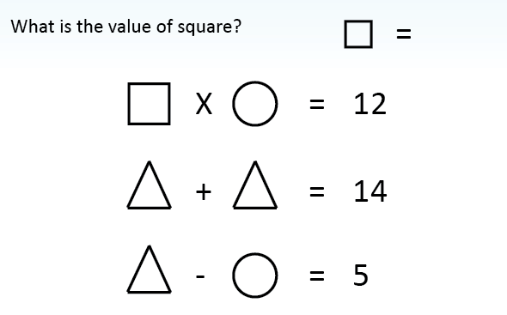
Perseverance Challenge
Work with your partner to complete the challenge activities.

Slide 14
Perseverance Challenge —Debrief Questions
Answer the Challenge Debrief Questions.
Respond to the Experience Debrief Questions.
Be ready to share and discuss your responses.

Slide 15
Learning Target
I take the initiative to contribute positively and approach challenges head-on.

Slide 16
Session Wrap-Up
Think about the learning targets.
Complete MA WBLP section.
How comfortable are you with the learning targets?
Not sure Working on it Almost there I Can Do It
What have you have learned today? How can you apply it?

Slide 17
Taking Initiative and Persevering
Module 8A

Slide 19
Overcoming Obstacles
Module 8B

Slide 20
Learning Target
I take the initiative to contribute positively and approach challenges head-on.

Slide 21
What Do You Think: A Closer Look at Obstacles
Can the obstacle or situation be removed?

Slide 22
A Closer Look at Obstacles
How do you remove the obstacle?
Will gathering more information help?
Are there people who can help remove the obstacle?
Will effort and/or time make a difference?
Can you think of anything else that could help?
How do you work around the obstacle?
Is there another way to achieve your central goal?
Are there people that can help counteract the obstacle or situation?
Can you adjust your reaction to obstacle?
How do you develop a long-term and short-term plan?
What steps can take that will put you on a path to removing the obstacle?
What actions can you take to work around the situation in the short-term?
What is the best way to track the situation?

Slide 23
Challenge Activity: Journaling About Your Obstacles
Clear description
Details about how you feel
Explanation of how to address this obstacle
Next steps

Slide 24
Next Steps and Action Plans
Option 1:
Write your goal using the chart provided.
What steps have you taken to complete this goal?
Prepare to share with the larger group.

Slide 25
Next Steps and Action Plans
Option 2:
What is your goal?
What steps have you taken to complete this goal?
What are some next steps toward completing this goal?
Prepare to share with the larger group.

Slide 26
What actions or attitudes do you think would impress supervisors and colleagues during a feedback process?

Slide 27
Goal Gallery Walk
Write your career goal on the chart paper.
Go to someone else’s goal and write one specific next step for the goal (education, resources, etc.).
Rotate to another goal and write a next step. You should write next steps on at least five different goals.
Return to your chart paper and read the comments.

Slide 28
Self-Rating
If an employer or professor was observing, what rating would you receive?

Slide 29
Learning Target
I take the initiative to contribute positively and approach challenges head-on.

Slide 30
Session Wrap-Up
Think about the learning targets
How comfortable are you with the learning targets?
Not sure Working on it Almost there I Can Do It
What have you have learned today? How can you apply it?

Slide 31
Overcoming Obstacles
ELL Accommodation

Slide 32
A Closer Look at Obstacles
Can the obstacle/situation be removed?
YES
Maybe (in time)
NO

Slide 33
A Closer Look at Obstacles
YES
Maybe (in time)
NO
How do you remove the obstacle?
Will more information help?
Who can help?
Will effort help?
Will time help?
How do you make a long-term and short-term plan?
What can you do to work around it? What steps can will help remove the obstacle?
How can you track progress?
How do you work around the obstacle?
Is there another way to reach the goal?
Who can support the goal?
Can you react in a different way?

Slide 34
Taking Initiative and Persevering in the Face of Obstacles
Module 8

