Slide 1
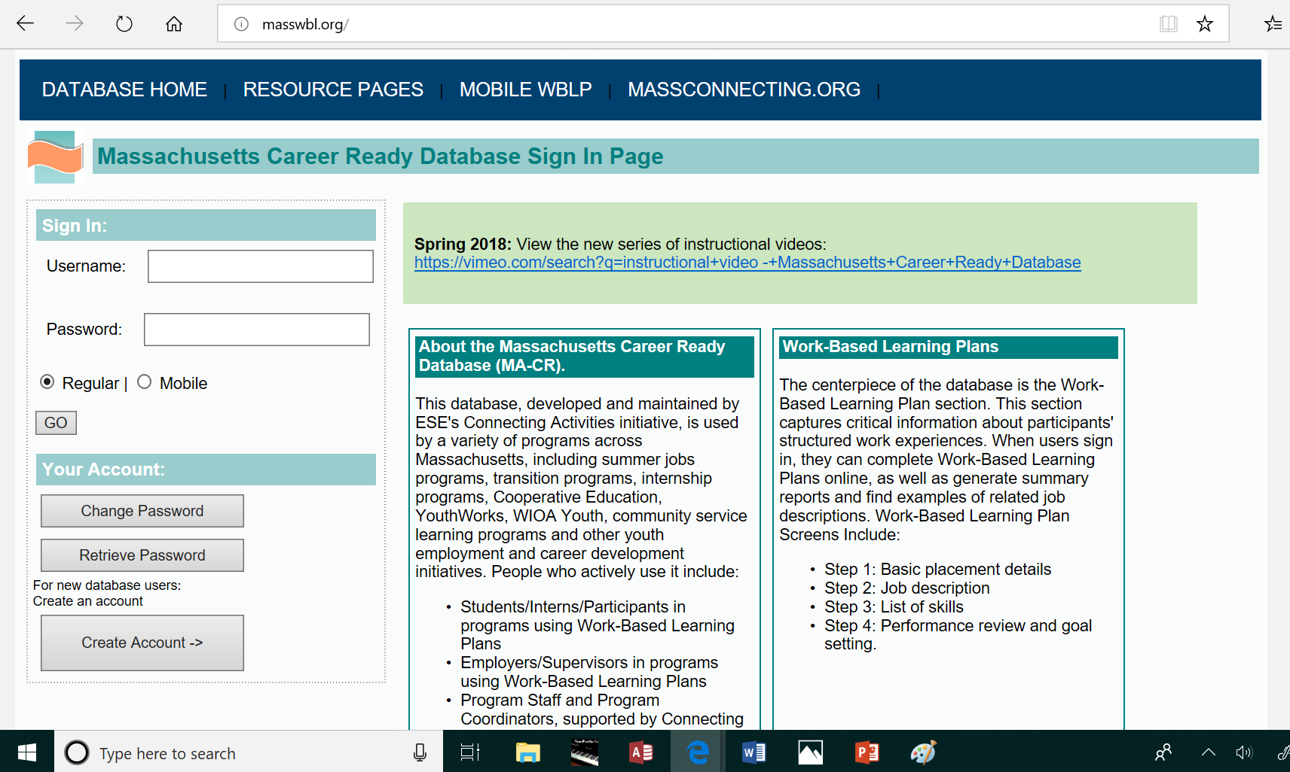
Sign in from the screen https://masswbl.org with your username and password.
You can use the “RETRIEVE PASSWORD” button to have your sign-in information emailed to you.

Slide 2
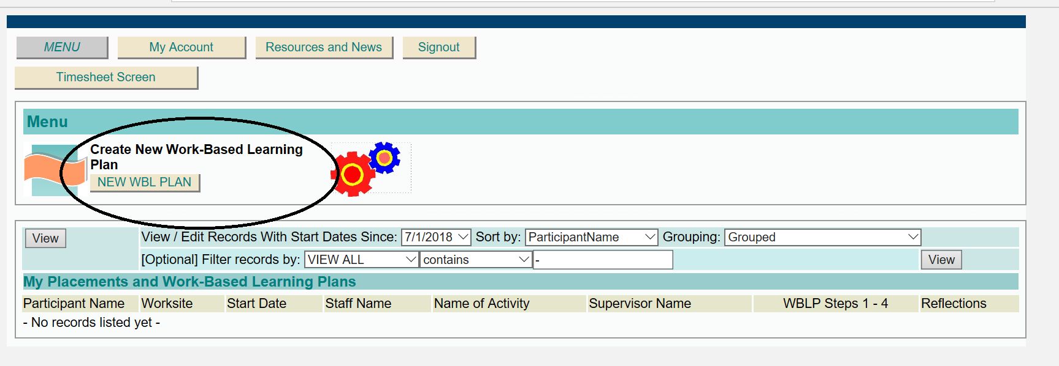
From the main menu page, click NEW WBL PLAN.”
Once you start filling in your WBL Plan screens, your name will appear here. You will be able to click to open the screens and continue working.

Slide 3
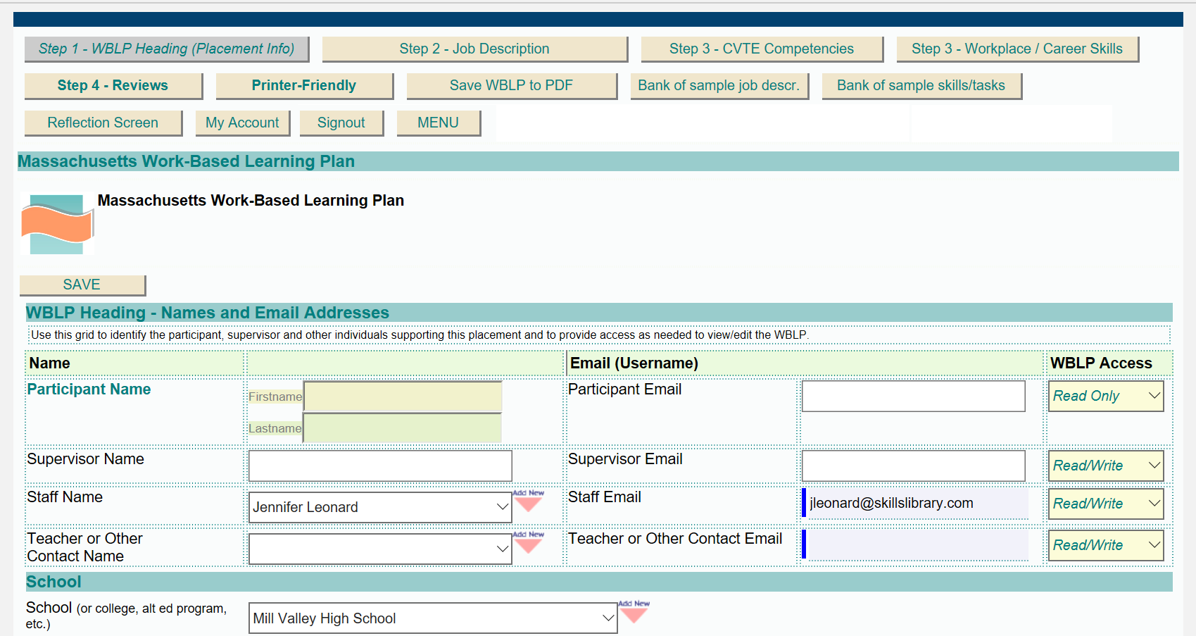
After you click “ADD NEW WBLP” you will see this screen. On this screen you fill in the basics about the work experience placement, including your name (Participant Name) and the name of your program coordinator, teacher, supervisor or any other individuals who should be able to view and/or update the Work-Based Learning Plan. For each person listed, include an email address, since we use email addresses as usernames for these screens.

Slide 4
The screen prompts you for the name of your school and for details about the employer – the worksite where you are working.
If you are doing an internship at your high school, fill in the name and address of your school as your employer.

Slide 5
The “Employer Type” asks whether the worksite is a private business, such as a store, restaurant, lawyer’s office or doctor’s office, OR a non-profit organization, such as a YMCA, Boys and Girls Club, or hospital, or a public (government) organization, such as a public school, city hall, or local parks department. If you aren’t sure, many organization websites mention whether the organization is a nonprofit organization or other type of organization.

Slide 6
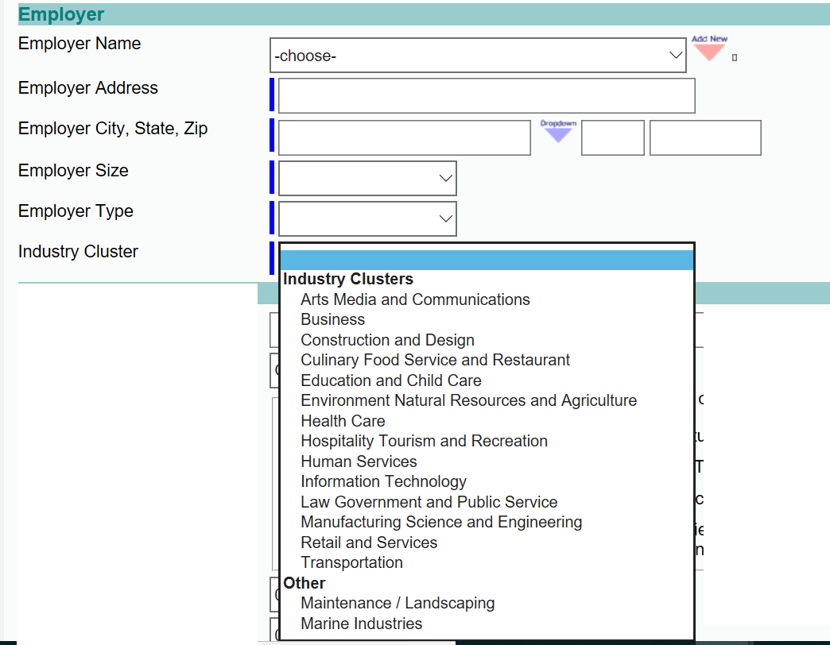
The “Industry Cluster” describes the type of organization. For example, if you work in a hospital, doctor’s office, or nursing home, choose “Health Care.” If you work in a school, choose “Education and Child Care.” If you work for a software company, choose “Information Technology.” Make your best guess to choose the industry cluster that best describes the organization where you are working.

Slide 7
In the section for PLACEMENT DETAILS, fill in your job title, such as “Software Intern” or “Summer Parks Assistant” or “Teaching Assistant.” Then choose a career area from the CAREER FOCUS AREA list that best describes the type of work you will do. Use your best guess, since many jobs don’t fit exactly into any of the categories.
Then check any of the boxes below that best describe the focus of your work experience – is it aligned with a career program that you are studying, such as a Carpentry or Engineering or Health Care Pathway? Is it aligned with any of your personal career goals or interests?

Slide 8
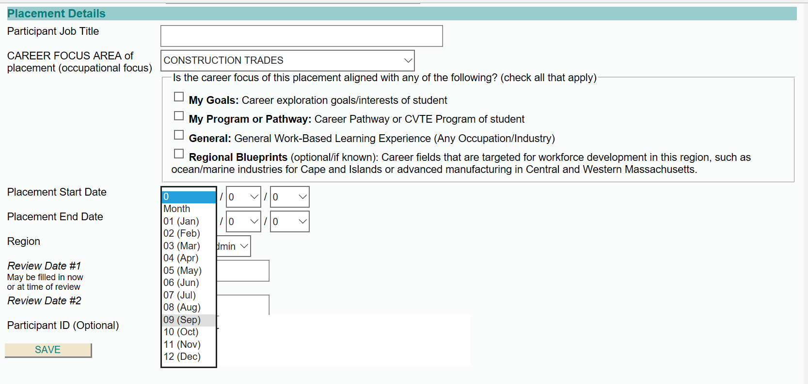
Fill in the expected START DATE and END DATE for the placement, using the month, day and year format.
If you expect to stay in the placement beyond the end of this school year, please enter June 30th as the end date.

Slide 9
CLICK SAVE once you have filled in the screen.
Use the navigation buttons along the top to continue to STEP 2 - JOB DESCRIPTION SCREEN and STEP 3 – Workplace/Career Skills.

